Slide 1

Operating systems
Storage Management
Venkatesh Prasad
Department of Computer Science

Slide 2
Operating systems
NFS
Venkatesh Prasad
Department of Computer Science

Slide 3
OPERATING SYSTEMS
Slides Credits for all PPTs of this course
The slides/diagrams in this course are an adaptation, combination, and enhancement of material from the following resources and persons:
Slides of Operating System Concepts, Abraham Silberschatz, Peter Baer Galvin, Greg Gagne - 9th edition 2013 and some slides from 10th edition 2018
Some conceptual text and diagram from Operating Systems - Internals and Design Principles, William Stallings, 9th edition 2018
Some presentation transcripts from A. Frank – P. Weisberg
Some conceptual text from Operating Systems: Three Easy Pieces, Remzi Arpaci-Dusseau, Andrea Arpaci Dusseau

Slide 4
OPERATING SYSTEMS
The Sun Network File System (NFS)
An implementation and a specification of a software system for accessing remote files across LANs (or WANs)
The implementation originally part of SunOS operating system, now industry standard / very common
Can use unreliable datagram protocol (UDP/IP) or TCP/IP, over Ethernet or other network

Slide 5
OPERATING SYSTEMS
NFS (Cont.)
Interconnected workstations viewed as a set of independent machines with independent file systems, which allows sharing among these file systems in a transparent manner
A remote directory is mounted over a local file system directory
The mounted directory looks like an integral subtree of the local file system, replacing the subtree descending from the local directory
Specification of the remote directory for the mount operation is nontransparent; the host name of the remote directory has to be provided
Files in the remote directory can then be accessed in a transparent manner
Subject to access-rights accreditation, potentially any file system (or directory within a file system), can be mounted remotely on top of any local directory

Slide 6
OPERATING SYSTEMS
NFS (Cont.)
NFS is designed to operate in a heterogeneous environment of different machines, operating systems, and network architectures; the NFS specifications independent of these media
This independence is achieved through the use of RPC primitives built on top of an External Data Representation (XDR) protocol used between two implementation-independent interfaces
The NFS specification distinguishes between the services provided by a mount mechanism and the actual remote-file-access services

Slide 7
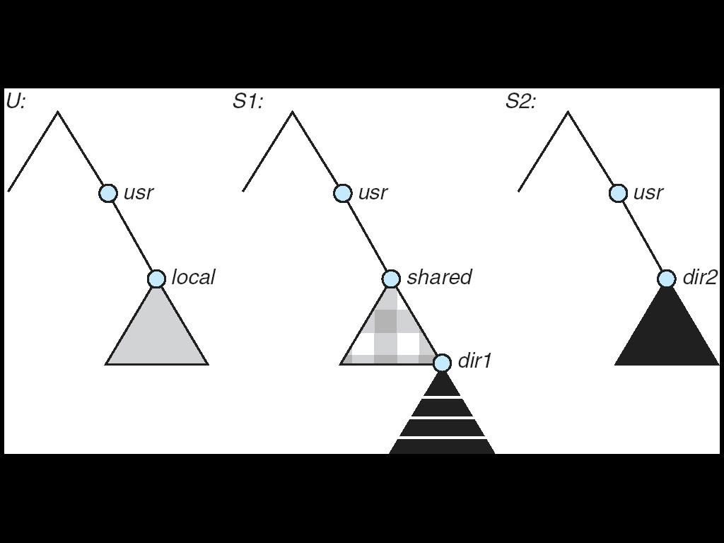
OPERATING SYSTEMS
Three Independent File Systems

Slide 8
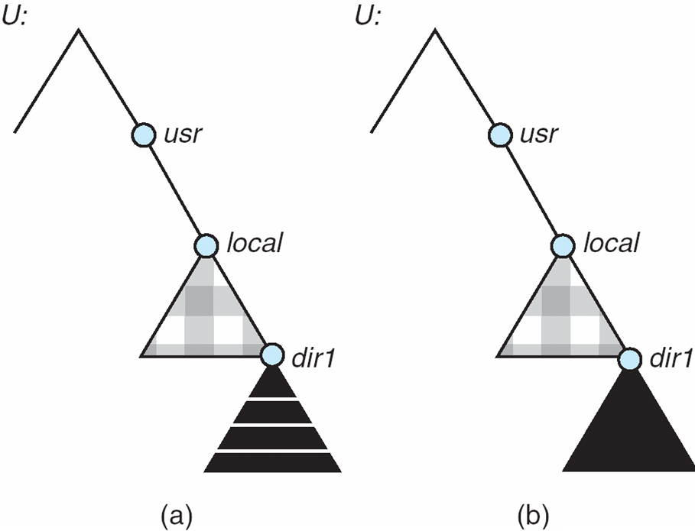
OPERATING SYSTEMS
Mounting in NFS
Effects of mounting S1:/usr/shared over U:/usr/local
Effects of mounting S2:/usr/dir2 over U:/usr/local/dir1
Mounts
Cascading mounts
Notes:
Effects of mounting S1:/usr/shared over U:/usr/local

Slide 9
OPERATING SYSTEMS
NFS Mount Protocol
Establishes initial logical connection between server and client
Mount operation includes name of remote directory to be mounted and name of server machine storing it
Mount request is mapped to corresponding RPC and forwarded to mount server running on server machine
Export list – specifies local file systems that server exports for mounting, along with names of machines that are permitted to mount them
Following a mount request that conforms to its export list, the server returns a file handle—a key for further accesses
File handle – a file-system identifier, and an inode number to identify the mounted directory within the exported file system
The mount operation changes only the user’s view and does not affect the server side

Slide 10
OPERATING SYSTEMS
NFS Protocol
Provides a set of remote procedure calls for remote file operations. The procedures support the following operations:
searching for a file within a directory
reading a set of directory entries
manipulating links and directories
accessing file attributes
reading and writing files
NFS servers are stateless; each request has to provide a full set of arguments (NFS V4 is just coming available – very different, stateful)
Modified data must be committed to the server’s disk before results are returned to the client (lose advantages of caching)
The NFS protocol does not provide concurrency-control mechanisms
A write() system call may be broken down to several RPC writes
2 users writing to the same remote file may get their data intermixed.
Notes:
Servers do not maintain information about their clients from one access to another

Slide 11
OPERATING SYSTEMS
Three Major Layers of NFS Architecture
UNIX file-system interface (based on the open, read, write, and close calls, and file descriptors)
Virtual File System (VFS) layer – distinguishes local files from remote ones, and local files are further distinguished according to their file-system types
The VFS activates file-system-specific operations to handle local requests according to their file-system types
Calls the NFS protocol procedures for remote requests
NFS service layer – bottom layer of the architecture
Implements the NFS protocol

Slide 12
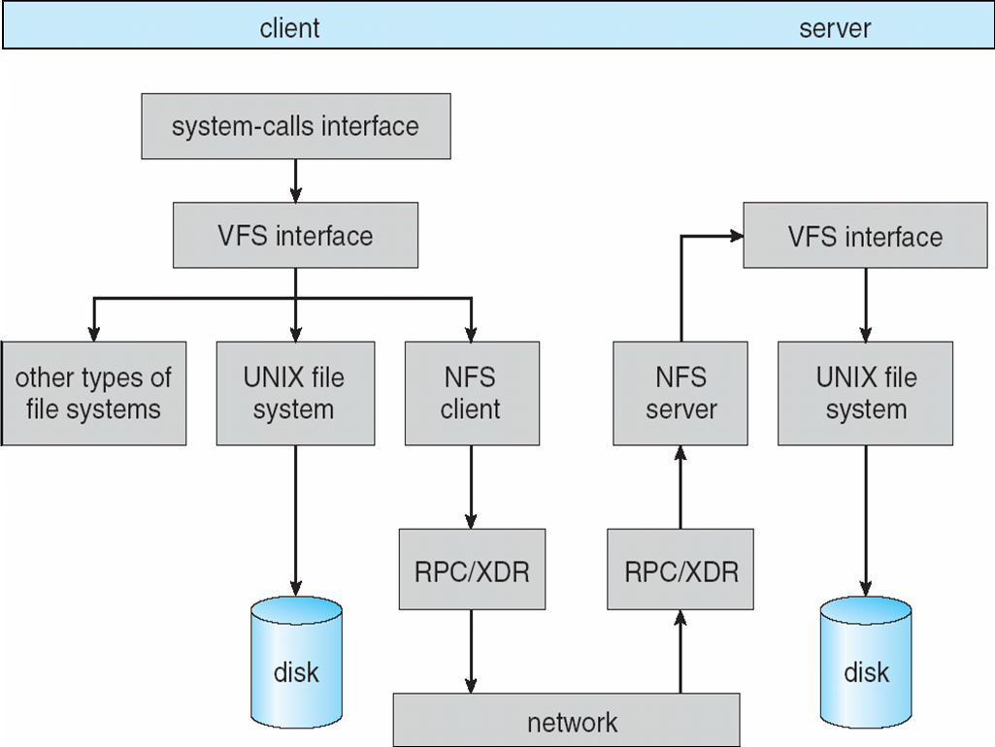
OPERATING SYSTEMS
Schematic View of NFS Architecture
RPC primitives built on top of an external data representation (XDR) protocol to operate in a heterogeneous env of different machines
Notes:
External data representation (XDR) is a standard for the description and encoding of data.
The XDR protocol is useful for transferring data between different computer architectures and has been used to communicate data between very diverse machines.

Slide 13
OPERATING SYSTEMS
NFS Path-Name Translation
Performed by breaking the path into component names and performing a separate NFS lookup call for every pair of component name and directory vnode
To make lookup faster, a directory name lookup cache on the client’s side holds the vnodes for remote directory names

Slide 14
OPERATING SYSTEMS
NFS Remote Operations
Nearly one-to-one correspondence between regular UNIX system calls and the NFS protocol RPCs (except opening and closing files)
NFS adheres to the remote-service paradigm, but employs buffering and caching techniques for the sake of performance
File-blocks cache – when a file is opened, the kernel checks with the remote server whether to fetch or revalidate the cached attributes
Cached file blocks are used only if the corresponding cached attributes are up to date
File-attribute cache – the attribute cache is updated whenever new attributes arrive from the server
Cached attributes are, by default, discarded after 60 seconds.
Clients do not free delayed-write blocks until the server confirms that the data have been written to disk

Slide 15

THANK YOU
Venkatesh Prasad
Department of Computer Science Engineering
venkateshprasad@pes.edu

